Slide 1
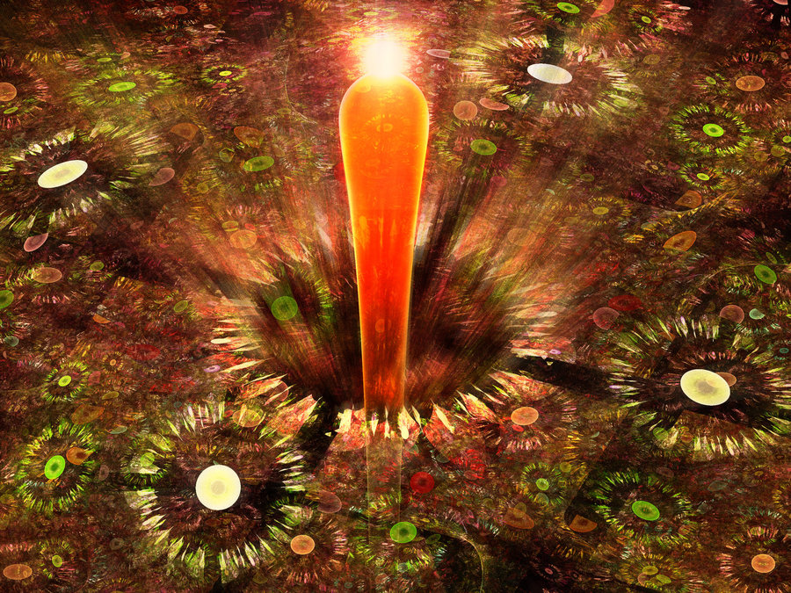
New models for kimberlite parental melts: composition, temperature, ascent and emplacement

Slide 2
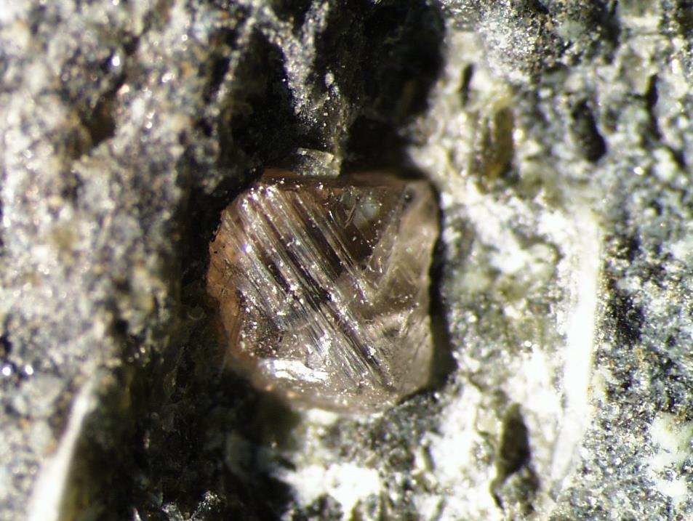
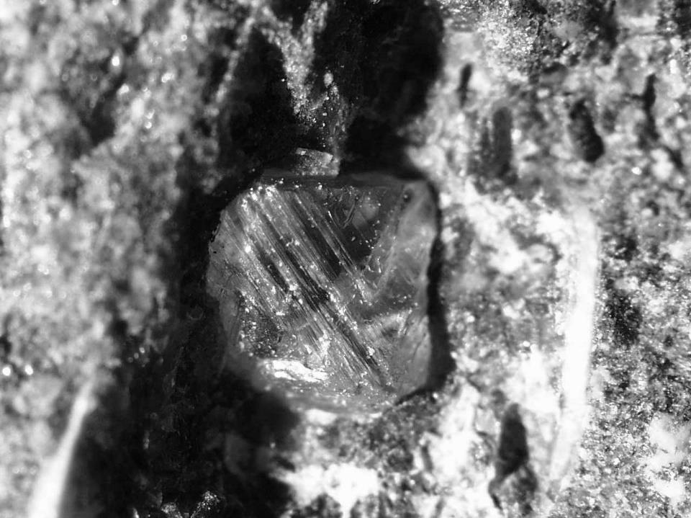
Kimberlites: a major source of diamonds
are exceptionally rare, but widespread on all major cratons;
originate in a diamond-stability field (> 40 kbar), but do not crystallise diamonds;
are fast ascending from mantle depths with a load of mantle and crustal xenoliths;
are emplaced in small-volume dykes and diatremes;
highly explosive emplacement and eruptions;
“…is regarded by …the geological and geochemical
community with an aura of glamour and mystique” (Eggler, 1989)

Slide 3
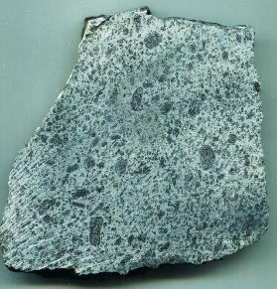
Kimberlite Parental Melt: existing dogma
Aphanitic Whole Rocks
Parental Melt
Definition: “Kimberlites are a clan of volatile-rich (dominantly CO₂) potassic ultrabasic rocks….” (R. H. Mitchell, 1986)
Hypabyssal group-I kimberlites are:
1. Ultramafic (MgO> 22 wt%; Mg# > 85);
2. High-Fo olivine cumulate, rare other minerals, no liquidus pyroxenes;
3. Low “basaltic” component:
high SiO₂/Al₂O₃>8, low Na₂O < 0.2 wt%;
4. Strong and variable hydration >2.7 wt% H₂O (serpentine), H₂O/CO₂ >1;
5. Exceptional enrichment in incompatible trace elements and depletion in HREE
Unnamed kimberlite from Antarctica
Problem: “…the kimberlitic rock is both a contaminated and altered sample of its parent melt” (J. D. Pasteris, 1984)

Slide 4
What is wrong with an ultrabasic melt…?
Phenocrysts assemblage: olivine phenocrysts only, “melt”-olivine disequilibrium, no other common phenocrysts (pyroxenes & plagioclase;
Composition: mismatch between low-Al, low-Na kimberlite and other silicate magmas;
Composition: mismatch high Mg# (high-F) and trace/volatile elements enrichment (low-F);
Temperature: mismatch between calculated temperatures calculated (>1350ºC) and “recorded” temperatures (<800ºC);
Rheology: mismatch between inferred mush of ultramafic melt + abundant solids (crystals/xenoliths) and low viscosity – low density - high buoyancy;
Unique explosivity style: what explodes in the ultramafic magma?

Slide 5
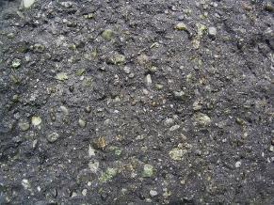
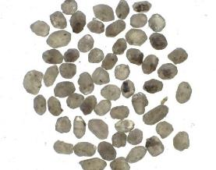
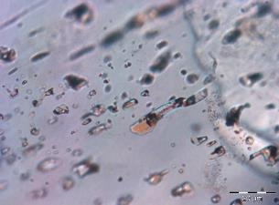
Our approach to kimberlite parental melt
Study of least altered kimberlite samples;
Study of groundmass assemblage;
Study of olivine phenocrysts;
Study of melt inclusions in olivine, Cr-spinel, perovskite, apatite, monticellite, phlogopite etc
Prerequisite: kimberlites from Udachnaya-East (Siberia), EKATI cluster, Gahcho Kué, Diavik, Jericho (Canada), Majuagaa (W. Greenland), Wesselton, Bultfontein, Venetia (S. Africa), pipe #1 (Finland) and Antarctica.

Slide 6
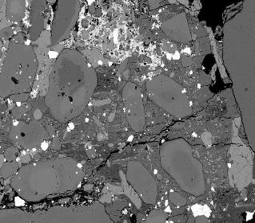
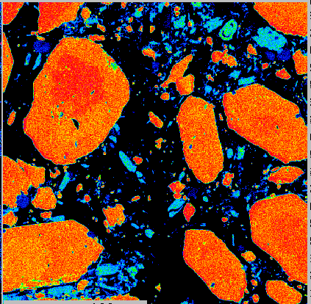
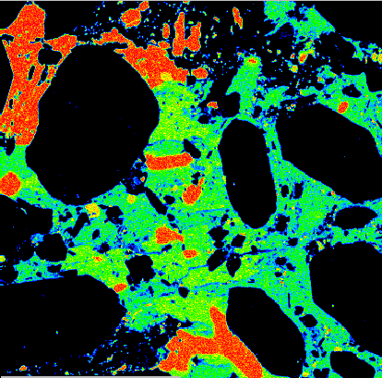
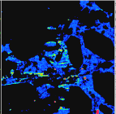
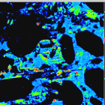
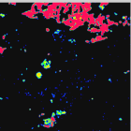
Udachnaya-East : an unaltered “flagship” in kimberlite family
10
altered kimberlites worldwide
Udachnaya
 | wt%
SiO₂ | 26.71
TiO₂ | 1.25
Al₂O₃ | 1.75
FeO | 8.09
MnO | 0.14
MgO | 31.33
CaO | 12.19
Na₂O | 3.23 <0.4
K₂O | 1.33
P₂O₅ | 0.49
SO₃ | 0.48
CO₂ | 9.42
H₂O | 0.38 >2.7
Cl | 2.38
Total | 99.17
H₂O-leach | 9.24
Greenland
Gahcho Kue
Jericho
Aaron
H₂O, wt%
Leslie
1
alteration
fresh Udachnaya-East kimberlites
0.1
0.01
0.1
Na₂O, wt%
1
10
100μm
Mg
Ca
Na
S
K
Cl

Slide 7
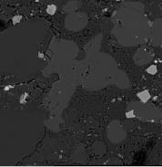
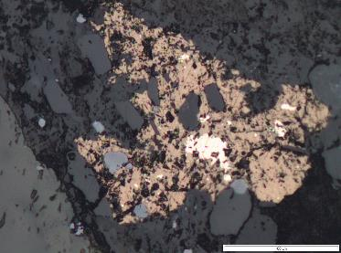
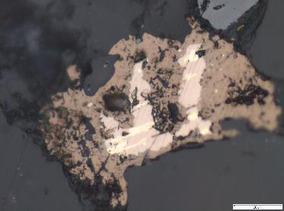
Udachnaya-East : an unaltered “flagship” in kimberlite family
Sodalite Na₈Al₆Si₆O₂₄Cl
Djerfisherite K₆(Cu,Fe,Ni)₂₅S₂₆Cl
Rasvumite KFe₂S₃
clc
ol
clc
ol
50μm

Slide 8
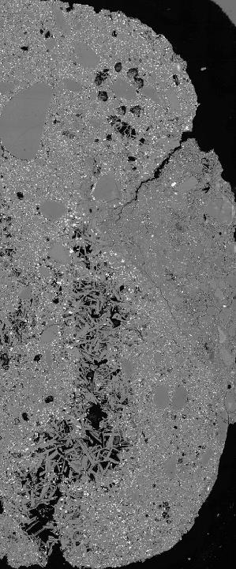
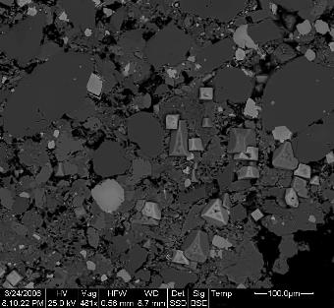
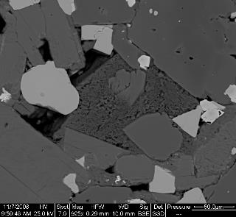
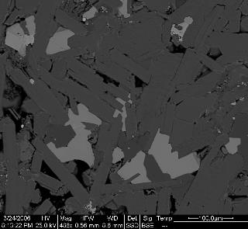
Udachnaya-East : an unaltered “flagship” in kimberlite family
host kimberlite
Mantle origin:
isotope compositions (perovskite)
⁸⁷Sr/⁸⁶Sr = 0.7031
εNd = +5.0
εHf = +5.3
P
ac
P
ol
ol
P
mtc
ol
mtc
host kimberlite
P
s
h
perovskite-rich autolith
phl
P
ol
P
phl
phl
ac
P
ol
P
P
perovskite-rich autolith
phl
P
P
phl

Slide 9
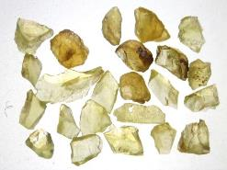
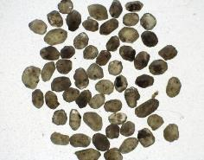
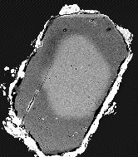
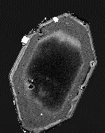
Udachnaya-East : an unaltered “flagship” in kimberlite family
Macrocrysts
Phenocrysts
N
N
35
18
30
25
14
20
10
15
10
6
5
2
85
86
87
88
89
90
91
92
93
94
95
85
86
87
88
89
90
91
92
93
94
95
0.5
NiO
0.5
NiO
0.4
0.4
0.3
0.3
0.2
0.2
0.1
85
87
89
91
93
Fo
95
0.1
Fo
85
87
89
91
93
95

Slide 10
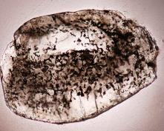
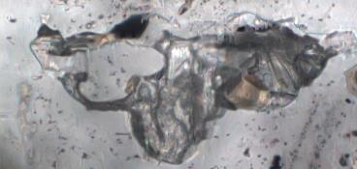
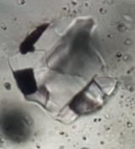
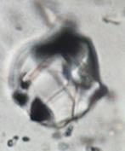
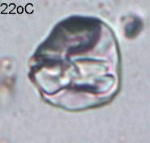
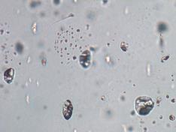
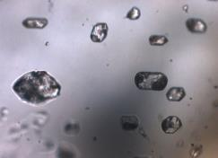
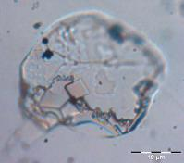
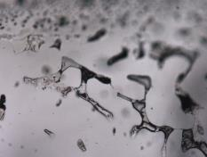
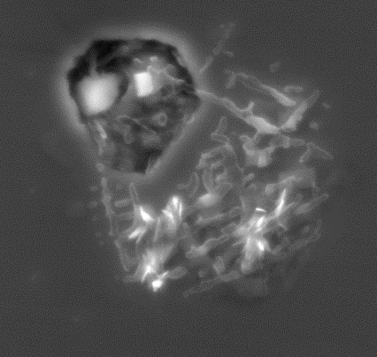
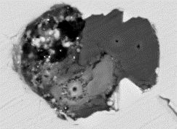
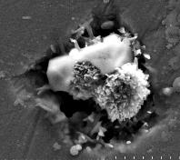
Alkali carbonate-chloride melt inclusions: common in ALL kimberlites
Udachnaya-East
20μm
20μm
20μm
Jericho
Leslie
20μm
50μm
Wesselton
Koala
(K,Na)Cl
D
(K,Na)Cl
N
aC
50μm
2μm
Tph
5μm
2μm

Slide 11
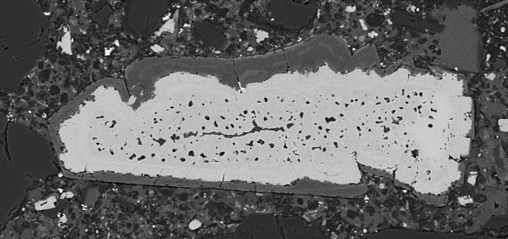
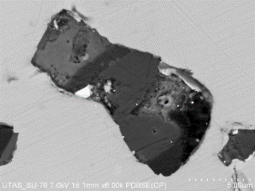
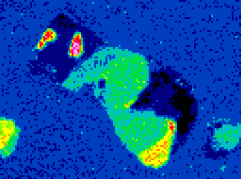
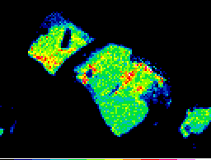
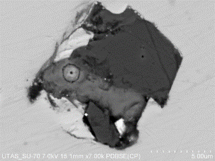
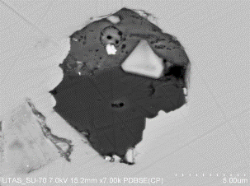
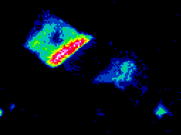
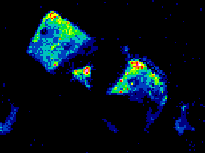
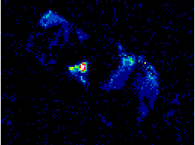
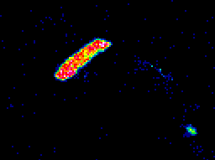
Alkali carbonate-chloride melt inclusions: common in ALL kimberlites
Cr-spinel, Koala pipe, EKATI cluster, Canada
1
2
Tph
3
4
aC
B
5
D
6
aC
7
8
9
MgO
Mg
Ca
100 μm
Tph
aC
Na
K
D
aC
D
Tph
Cl
P

Slide 12
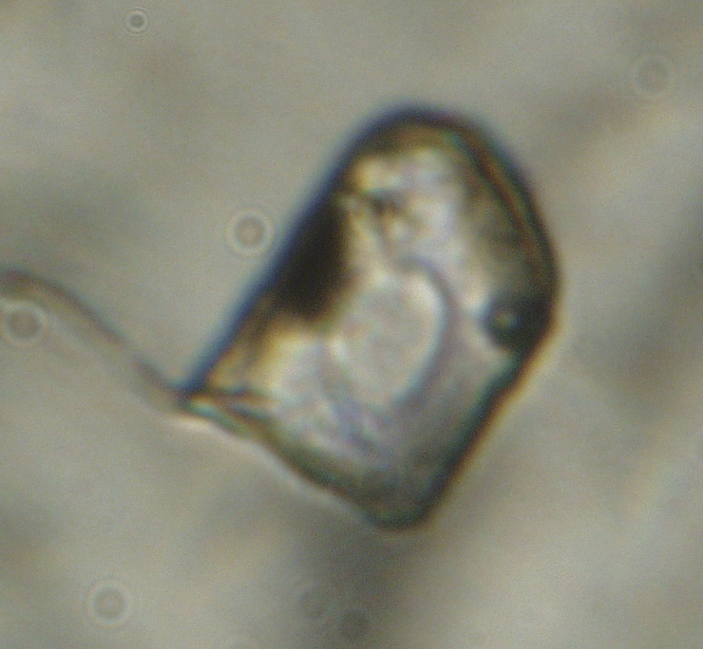
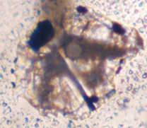
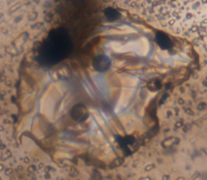
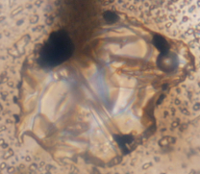





Melt homogenisation temperature ~ 670ºC;
Carbonate-chloride melt immiscibility < 670ºC:
common in ALL kimberlites
Olivine, Leslie kimberlite (EKATI cluster, Canada)
immiscibility 635ºC
Olivine, Udachnaya-East kimberlite (Siberia, Russia)
20ºC
heating 654ºC
homogenisation 646ºC
cooling/immiscibility 606ºC
Olivine, Koala kimberlite (EKATI cluster, Canada)
20ºC
heating 610ºC
homogenisation 667ºC
cooling/immiscibility 505ºC

Slide 13




Melt homogenisation temperature ~ 670ºC:
common in ALL kimberlites
Carbonate-chloride melt immiscibility < 670ºC:
common in ALL kimberlites

Slide 14






Udachnaya-East kimberlite: carbonate-chloride “pools” of residual melt
Chloride “nodules”

Slide 15




Udachnaya-East kimberlite: carbonate-chloride “pools” of residual melt
Carbonate- chloride “nodules”
nyerereite; shortite; northupite, halite, sylvite, apatite, aphthitalite, olivine, calcite, tetraferriphlogopite

Slide 16








Udachnaya-East kimberlite: carbonate-chloride “pools” of residual melt
melt inclusions in northupite
10 μm
20 μm
melt inclusions in shortite-hosted apatite
th
NaCl
KCl
NaCl
50 μm
50 μm
KCl
th
cl
ph
NaCl
ah
NaCl
NaCl
50 μm
10 μm
melt inclusion in olivine at ~590ºC

Slide 17




Carbonate-silicate melt immiscibility in the system 80%Na₂CO₃ – 20%Opx at mantle conditions: experimental approach
5.0 GPa, 1200º C
4.0 GPa, 1140º C
3.0 GPa, 1070º C
2.0 GPa, 1000º C
0.5 mm

Slide 18

New “kimberlite ascent” model: a storyline

Slide 19
Kimberlite emplacement: prevailing models
1. Fluidisation: rapid degassing and expansion of magmatic volatiles (CO₂ and H₂O) in an open system that creates “…a bed of particles, which develops fluid-like properties as a consequence of the flow of interstitial gas” (Sparks et al., 2006).
2. Hydrovolcanism/phreato- magmatism: interaction of magma or magmatic heat with an external source of water… “diatremes form on dykes in hard rocks ..wherever there is a local potential for thermohydraulic explosive interaction of the rising magma with groundwater contained in fractures and faults” (Lorenz & Kurszlaukis, 2007) .
V. Lorenz & S. Kurszlaukis, 2007
“Emplacement of the (Yubileinaya) pipe occurred over an extended time span with intermittent phases of volcanic quiescence and consolidation…. There is neither textural evidence that violent degassing of a juvenile gas phase has caused pipe excavation, nor that external water was present during the main phase of volcanic eruptions” (Kurszlaukis et al., 2009, Lithos)
Kimberlite emplacement: new model
Post-emplacement reaction between carbonatitic melt and olivine causes decarbonation and is driven by CO₂ outgassing

Slide 20

Kimberlite Magma emplacement: new facts
Kimberlite explosions are unexpectedly powerful for such small volumes
“The initial breakthrough of the magma at the surface is likely to have been violent and highly explosive…with excavation of the pipe from the top down, as the fragmentation surface in the magma column drops quickly upon vent opening” (Porritt & Cas, 2009)
“At Lac de Gras...excavated steep-sided pipes were empty to ~400-500 m depth before eventually being infilled by kimberlite” (Kopylova & Hayman, 2008)
“The sustained eruption proceeds to “drill” down into the country rock, efficiently excavating down to >750 m below surface” (Moss et al., 2009)
“…the (Venetia) K2 eruption was a protracted explosive event …presence of layered breccias and pyroclastic rocks to a considerable depth (>900 m) requires that the pipe was deeply excavated prior to filling” (Brown et al., 2009)
Explosions occur when kimberlite is cold and solid
“…Relatively fresh, often charred – but not petrified – wood found only in China today, has been encountered in drill core at depths up to 400 metres. …coniferous trees were uprooted and incorporated into the pipes” http://www.diavik.ca/Geo.htm
“From a few of the diamond pipes rare leaves, turtle bones and fish parts have been recovered….Abundant wood specimens ….are in various states of carbonization. Some specimens have not been exposed to any burning and look like normal cedar logs” www.napegg.nt.ca/newsletters/oct99
“Most clasts…show no evidence of being thermally metamorphosed. The presence of bituminous shale and carbonized wood indicate that high temperatures did not occur during diatreme emplacement ” (Mitchell, 1986)
Uncharred wood in Diavik kimberlite (photo Greg Yaxley)

Slide 21




What drives explosive emplacement of kimberlites?
Jericho, Canada
Pipe #1, Finland
Mtc -Br
Mtc
Mtc
Ol
Ol
Srp
Mtc
Ol
Mtc -Br
Mtc - Br
Srp
Mtc
100µm
100µm
Monticellite
Mg-wüstite
Monticellite
Mg-wüstite
Ferropericlase
Ferropericlase
Mg-wüstite
2.5 µm
2.5 µm
(Mg,Fe)₂SiO₄ + Na₂Ca₂(CO₃)₃ → Ca(Mg,Fe)SiO₄ + (Mg,Fe)O + Na₂Ca(CO₃)₂ + CO₂

Slide 22

Udachnaya (fortuitous)
Удачная model of kimberlite
1. new approach to kimberlite melt composition and temperature
2. new estimates of rheological properties of kimberlite magmas
3. new mechanism of the kimberlite magma ascent
4. new ideas on the source of explosive energy/forces

Slide 24

New kimberlite emplacement model: Rationale
1. Spontaneous outgassing: ~10⁵ m³/day of gases N₂, CH₄ and H₂ at 50-70 atm from deep boreholes drilled through the unaltered block of the Udachnaya-East kimberlite (Marshintsev, 1986; Drozdov et al., 1989)
CH₄
2. CH₄ and H₂ in olivine-hosted fluid inclusions in the Gahcho Kué kimberlite (Slave craton, Canada): Raman spectroscopy
H₂
3. CH₄ and H₂ are produced during serpentinisation of olivine: examples from present-day CH₄ and H₂ production in various continental (Abrajano et al., 1988; Neal and Stanger, 1983; Coveney et al., 1987; Charlou et al., 1998) and oceanic areas (Haggerty, 1991; Kelley, 1996) where mafic-ultramafic rocks are present.
15 Ol (Fo₉₀) + 20.5 H₂O →
Mt + 7.5 Serp + 4.5 brucite + H₂
CO₂ + 4 H₂ → CH₄ + 2 H₂O

Slide 25
New kimberlite emplacement model: a storyline
1. Emplacement of the kimberlite magma (~65% carbonate-chloride-silicate liquid + ~35% solids – olivine, mantle & crustal xenoliths and xenocrysts) as subsurface dykes
2. Gravitational separation of solids from the residual carbonate-chloride liquid in dykes. Olivine-rich cumulates with interstitial melt (“root zones” of hypabyssal kimberlites). Solidifying melt-rich zones with scattered solids in the upper parts of dykes.

Slide 26
New kimberlite emplacement model: a storyline
3. Water-soluble alkali carbonates and chlorides are leached out. Interconnected caverns are created throughout upper parts of dykes; whereas water causes serpentinisation of olivine in the “root zones”
4. Cavernous system act as a “vacuum pump” for free gases in this environment: magmatic, postmagmatic and ambient gases (mixture of air, water vapour and magma-derived volatiles).

Slide 27












New kimberlite emplacement model: a storyline
5. Gas-mixing and pressurisation (by expanding serpentine) in caverns cause detonation. One explosion may cause chain reaction by sending shock waves.
6. Vertical and lateral explosive boring. Fragmentation inside the dyke system and country rocks . Collapse of rocks from the top and walls Growth of carrot- shaped “diatremes” by excavation from top down. Natural autoclave for microdiamonds.

Slide 28

New “kimberlite emplacement” model: a storyline

